Slide 1
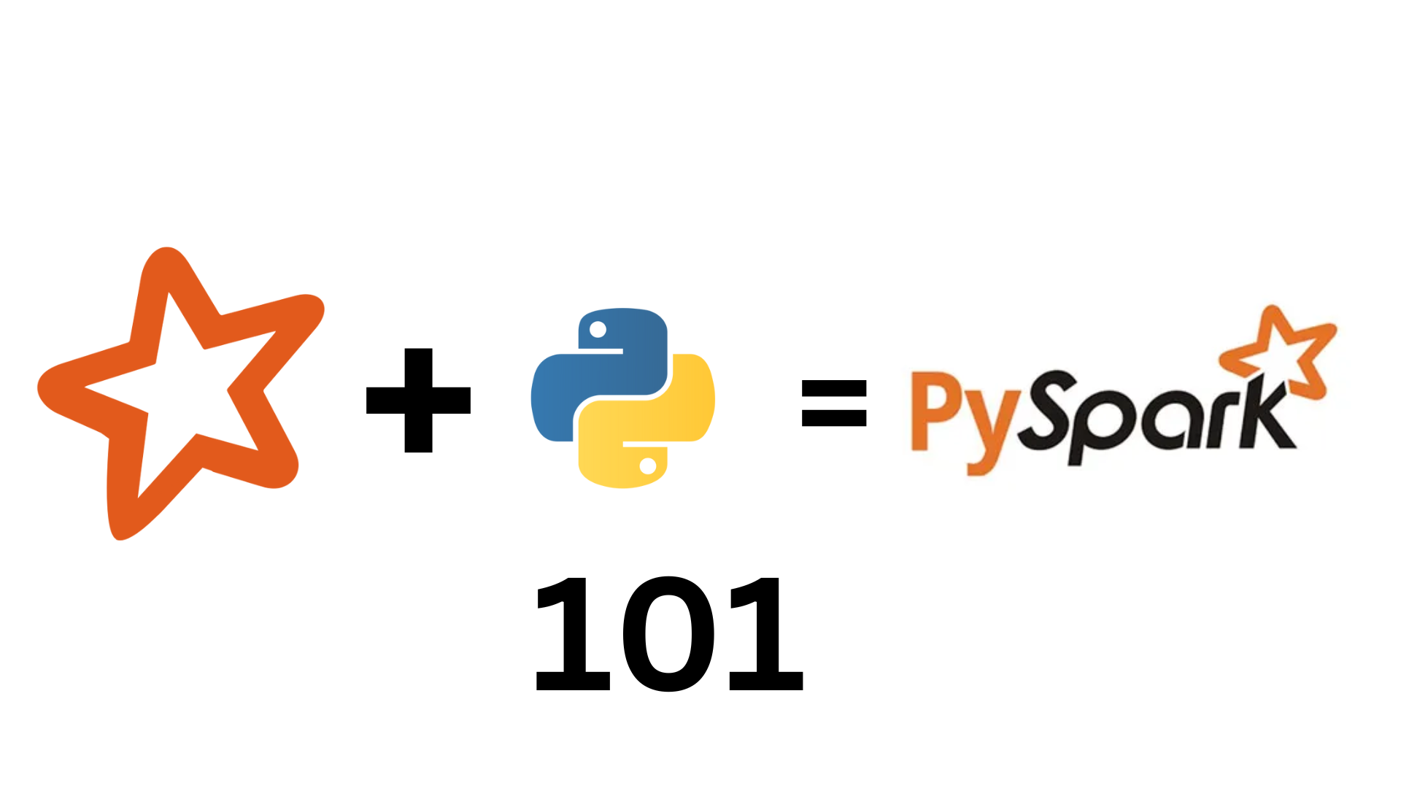
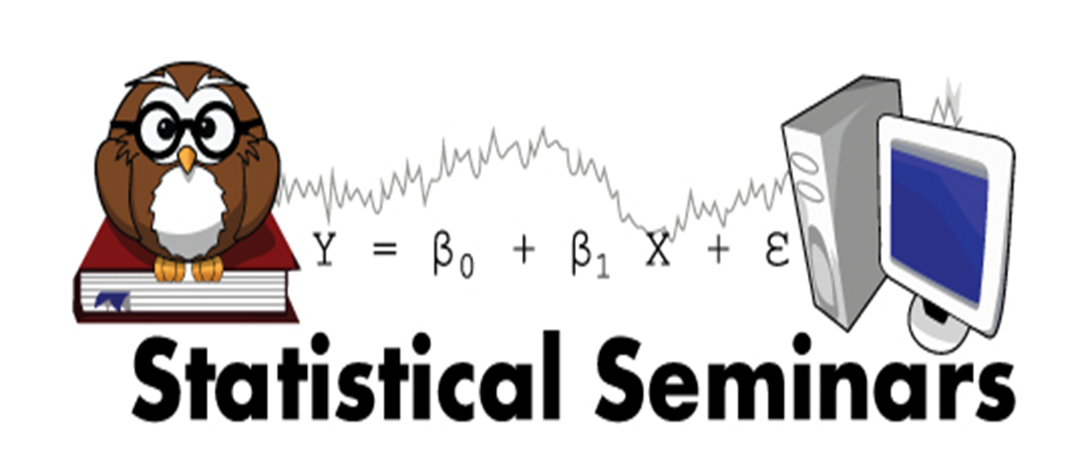

Slide 2
Agenda
What is Apache Spark
PySpark
RDD
Dataframe
SQL
Machine Learning- Ml

Slide 3
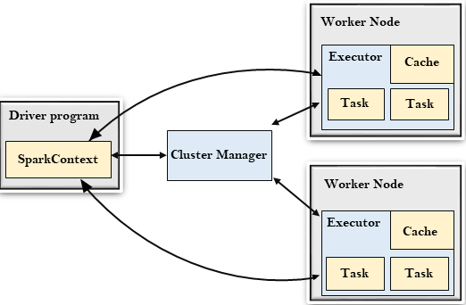
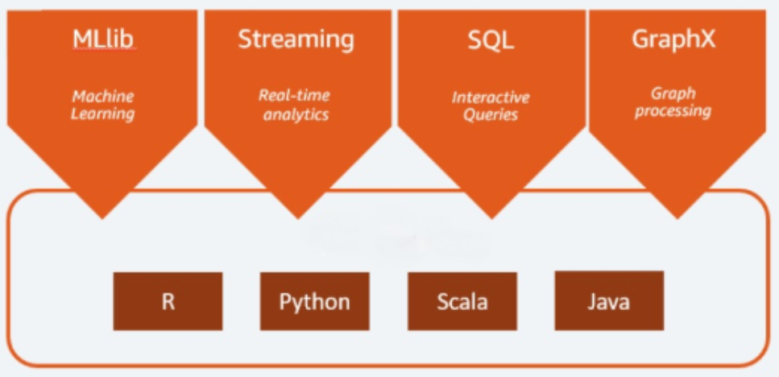
What is Apache Spark
Apache Spark is an open-source distributed cluster-computing framework introduced by Apache Software Foundation.

Slide 4
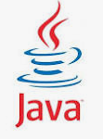
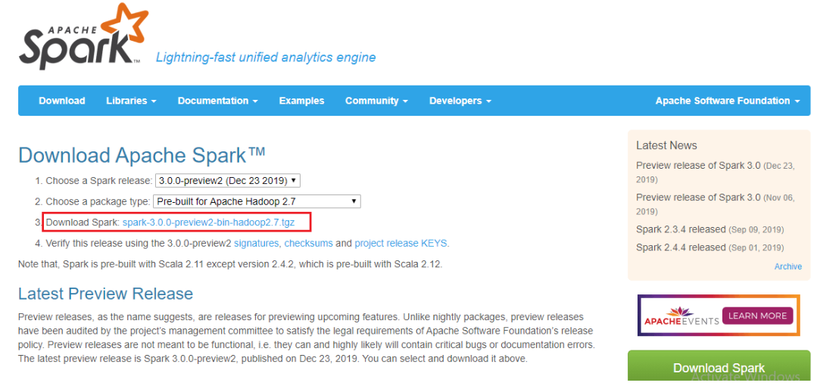
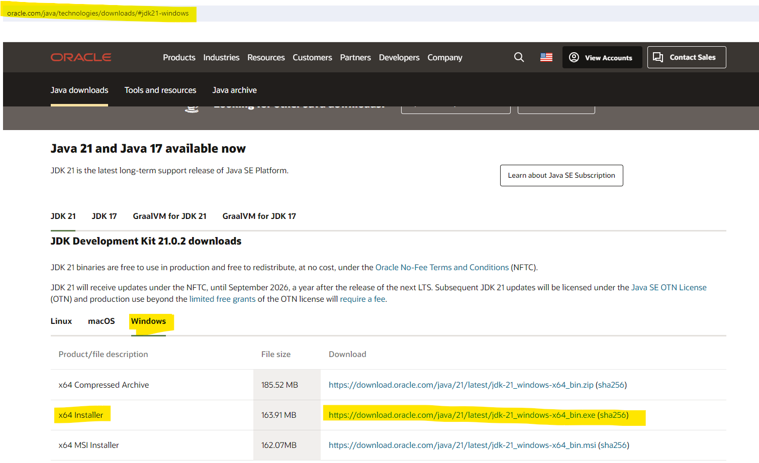
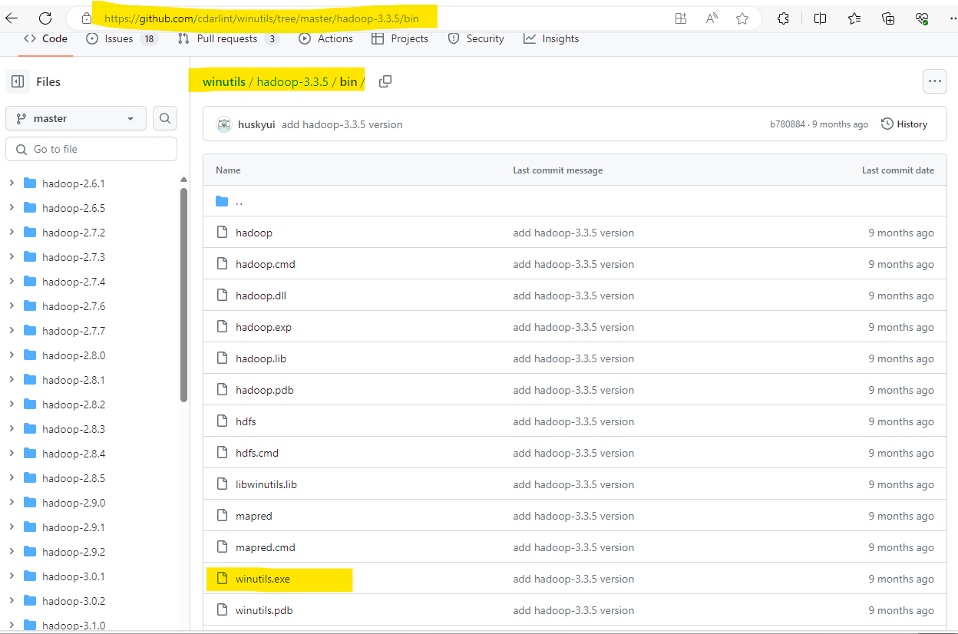
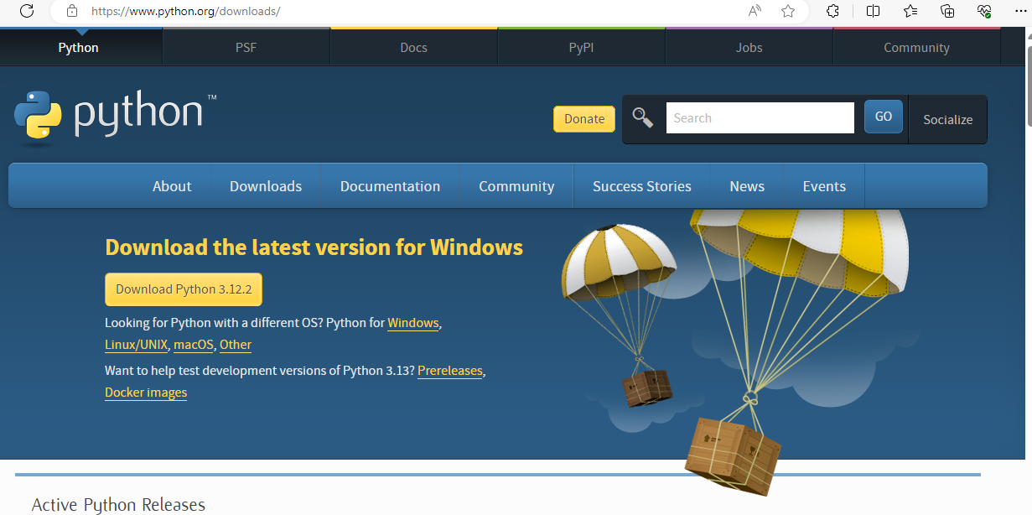
Installation
Java download
Python download
Spark download
Winutils download (elements of Hadoop)
Set environment variables…

Slide 5
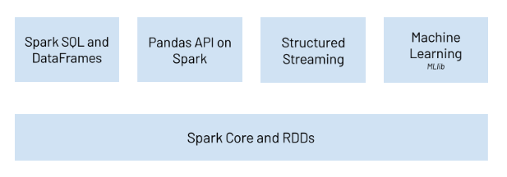
PySpark
& ML

Slide 6
PySpark –Resilient Distributed Datasets (RDD)
In-Memory – can store any size elements
Lazy Evaluations
Immutable elements,
Fault-tolerant
Parallel - RDDs are logically divided across the cluster

Slide 7
PySpark - Dataframe
Distributed collection of structured data.
Lazy Evaluation
Immutable

Slide 8
RDD & Dataframe
Transformation- operations that reads in data, manipulates it, and returns another format (eventually [Lazy]).
Action -operations that either returns a result or writes to the disc.

Slide 9
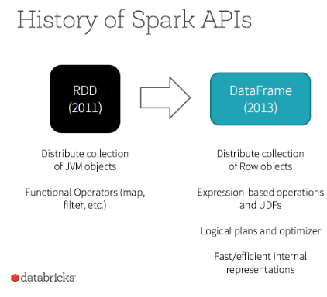
 | RDDs | Dataframes
Data Representation | RDD is a distributed collection of data elements without any schema. | It is also the distributed collection organized into the named columns
Optimization | No in-built optimization engine for RDDs. Developers need to write the optimized code themselves. | It uses a catalyst optimizer for optimization.
Projection of Schema | No Scheme. Need to define schema manually. | It will automatically find out the schema of the dataset.
Aggregation Operation | RDD is slower than both Dataframes and Datasets to perform simple operations like grouping the data. | It provides an easy API to perform aggregation operations. It performs aggregation faster than both RDDs and Datasets.

Slide 10


Slide 11
PySpark- SQL
You can make SQL queries and DataFrame operations. Once you have a DataFrame created, you can interact with the data by using SQL syntax

Slide 12
PySpark – Machine Learning [using pyspark.ml]
Machine learning module of Apache Spark.
Provides high-level APIs for common machine learning tasks like classification, regression, and clustering.
It provides a simple and easy-to-use API for building and deploying machine learning pipelines.

Slide 14
Thank you for coming

